Slide 1




THE DOMINATION IN GRAPHS
Vi Nguyen
University of North Florida
Department of Mathematics and Statistics

Slide 2
Outline
Motivating problem
Introduction of domination theory in a graph
Solve the problem
Bounds of a dominating number
Applications

Slide 3

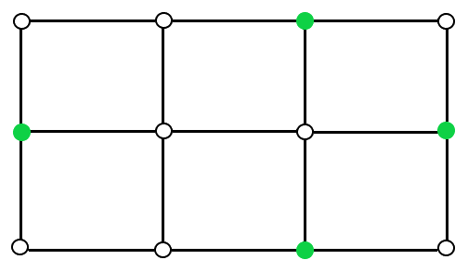
The Optimizing Puzzle
A city plans to build some security stations from which they can reach every intersection with the same amount of time.
The fewer stations, the better for the budget.
So, what is the minimum number of stations?
In the figure, 6 blocks are separated by 4 vertical and 3 horizontal streets.
Every vertex is an intersection.
The green vertices represent security stations.

Slide 4
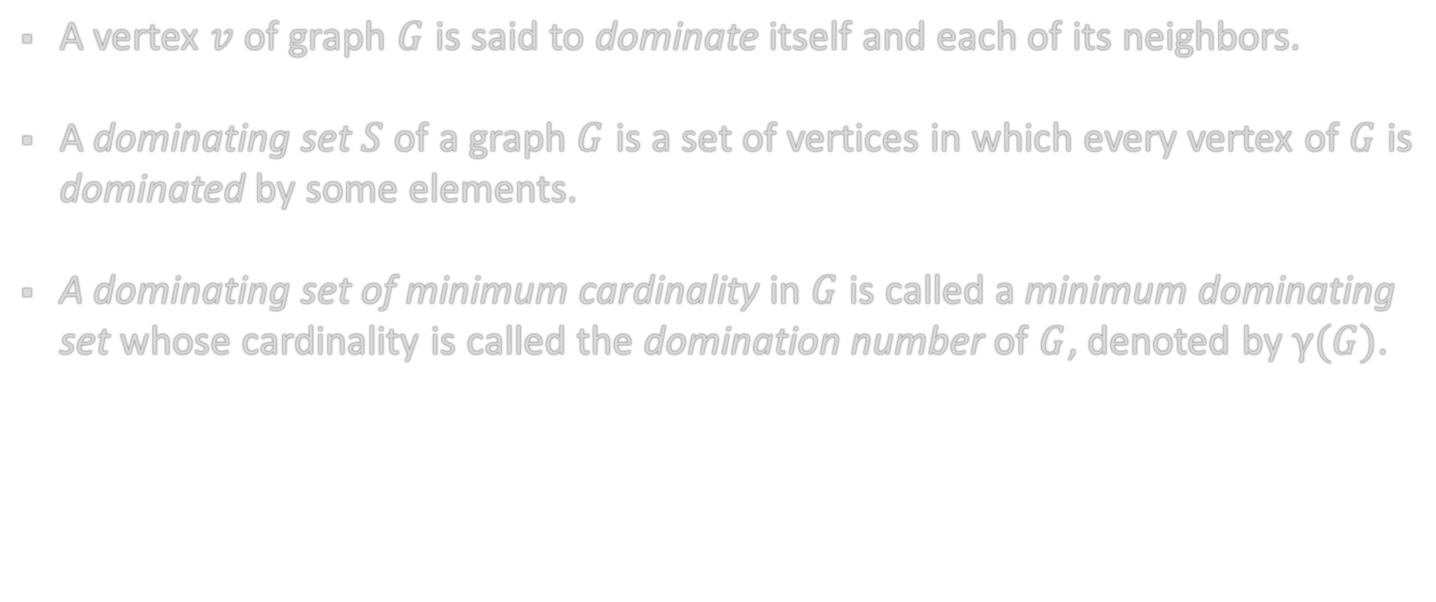
Domination in a Graph
A vertex $v$ of graph $G$ is said to dominate itself and each of its neighbors.
A dominating set $S$ of a graph $G$ is a set of vertices in which every vertex of $G$ is dominated by some elements.
A dominating set of minimum cardinality in $G$ is called a minimum dominating set whose cardinality is called the domination number of $G$, denoted by $γ(G)$.

Slide 5
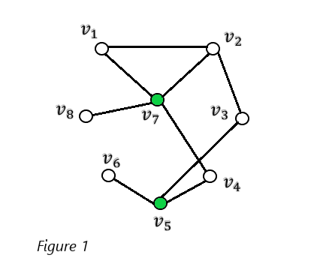
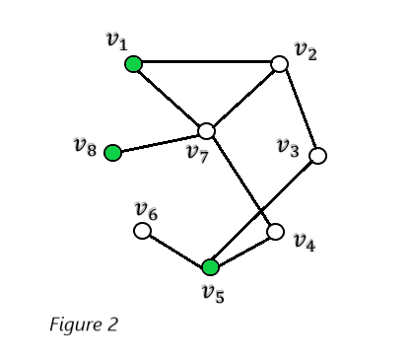
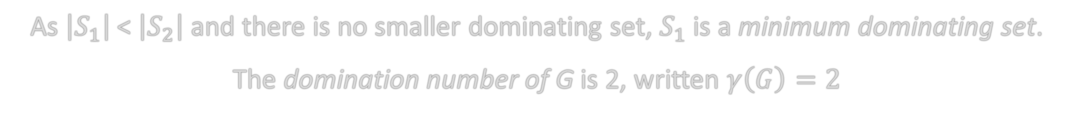
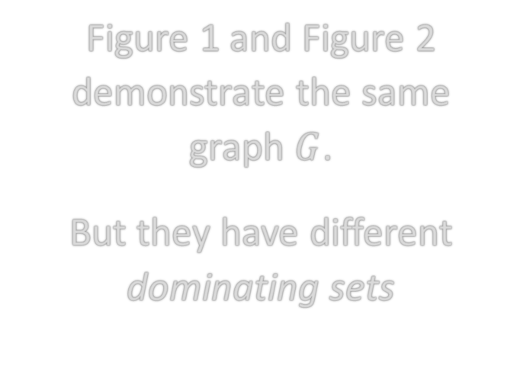

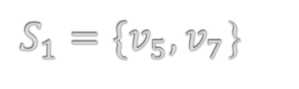
Examples of Dominating Sets
Figure 1 and Figure 2 demonstrate the same graph $G$.
But they have different dominating sets
$S_{1}=\{v_{5},v_{7}$}
$$S_{2}=\left\{v_{1},v_{8},v_{5}\right\}$$
As $\left|S_{1}\right|$ < $\left|S_{2}\right|$ and there is no smaller dominating set, $S_{1}$ is a minimum dominating set.
The domination number of G is 2, written $γ\left(G\right)=2$

Slide 6
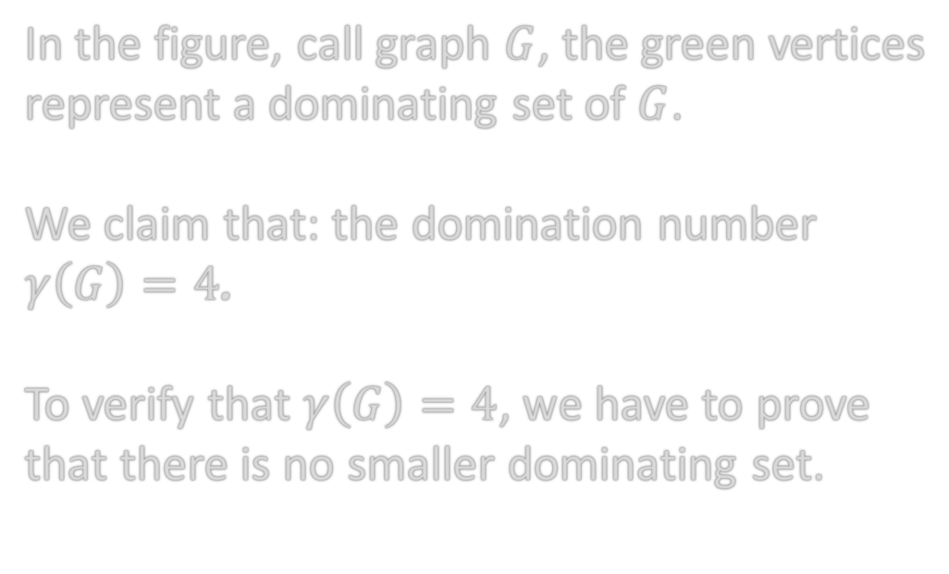
Solving the Puzzle
In the figure, call graph $G$, the green vertices represent a dominating set of $G$.
We claim that: the domination number $γ\left(G\right)=4$.
To verify that $γ\left(G\right)=4$, we have to prove that there is no smaller dominating set.
Let’s prove that a smaller dominating set, where $γ\left(G\right)<4$, does not exist!

Slide 7
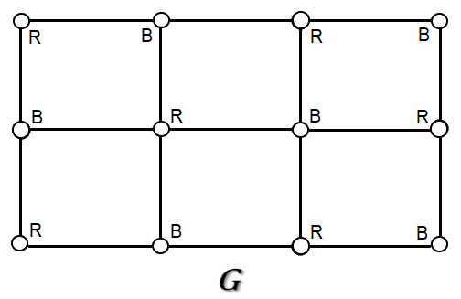
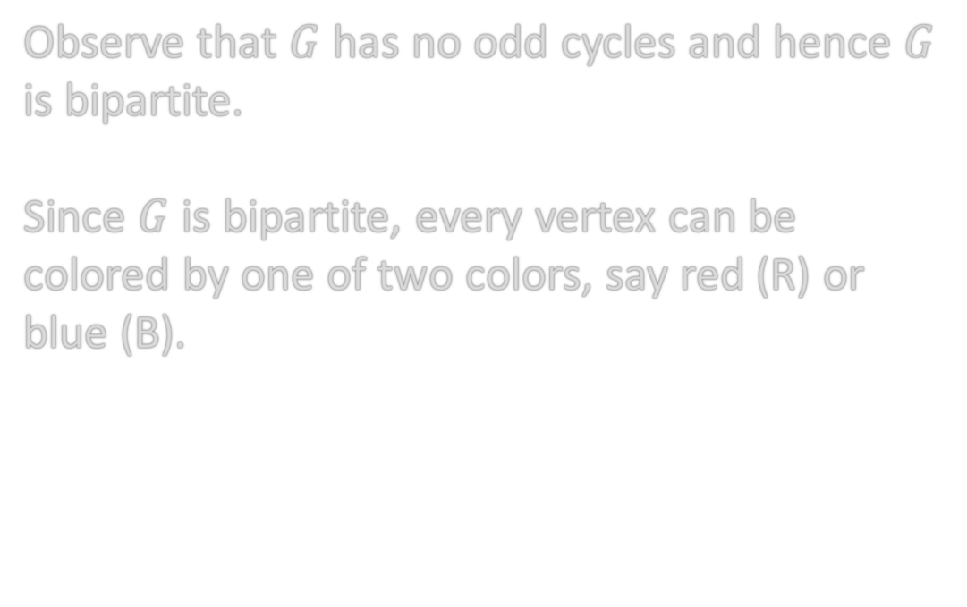
A Bipartite Graph
Observe that $G$ has no odd cycles and hence $G$ is bipartite.
Since $G$ is bipartite, every vertex can be colored by one of two colors, say red (R) or blue (B).

Slide 8
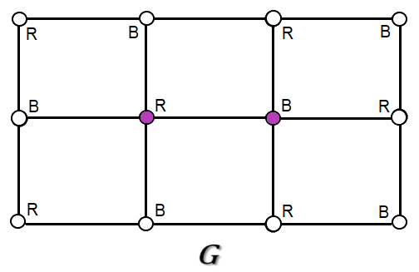
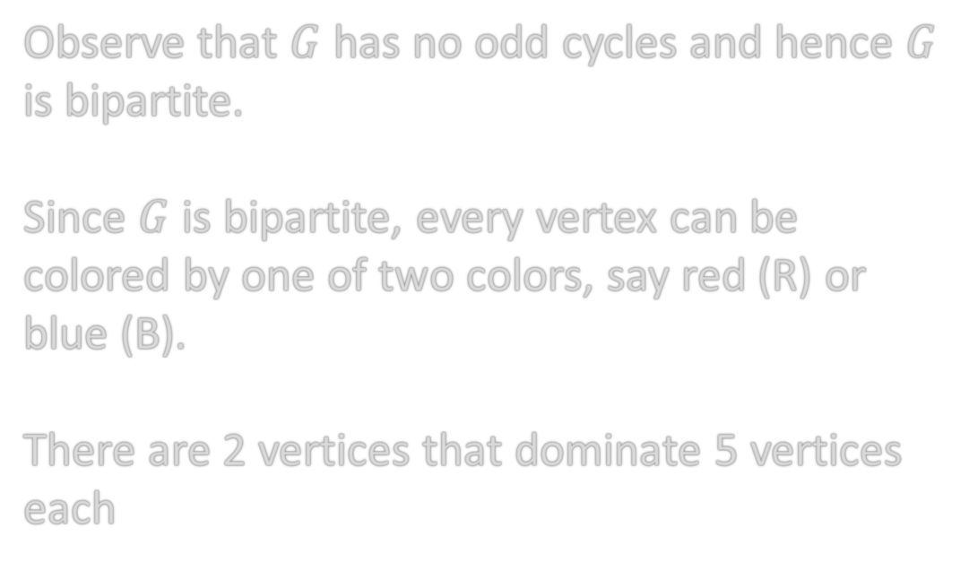
2 Vertices Dominate 5 Vertices Each
Observe that $G$ has no odd cycles and hence $G$ is bipartite.
Since $G$ is bipartite, every vertex can be colored by one of two colors, say red (R) or blue (B).
There are 2 vertices that dominate 5 vertices each

Slide 9
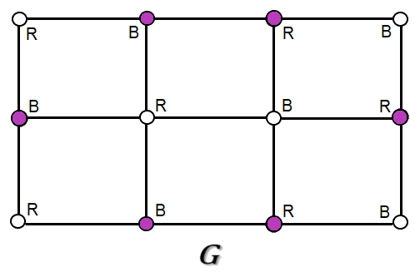
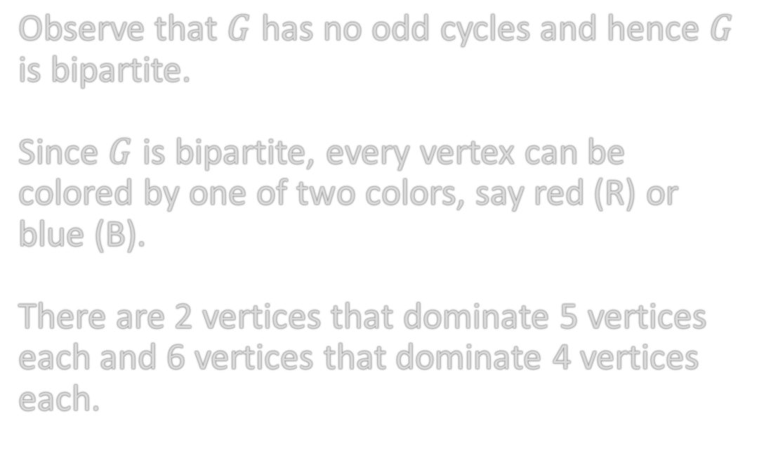
6 Vertices Dominate 4 Vertices Each
Observe that $G$ has no odd cycles and hence $G$ is bipartite.
Since $G$ is bipartite, every vertex can be colored by one of two colors, say red (R) or blue (B).
There are 2 vertices that dominate 5 vertices each and 6 vertices that dominate 4 vertices each.

Slide 10
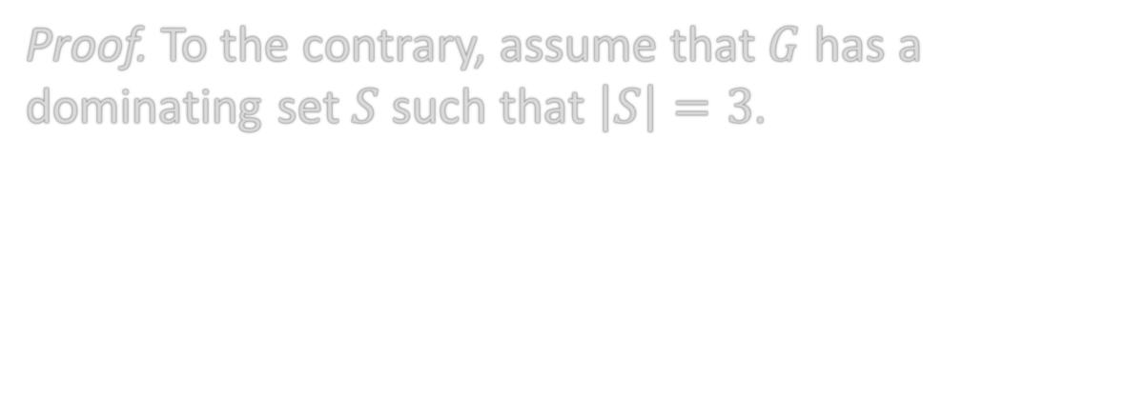
Proof by Contradiction
Proof. To the contrary, assume that $G$ has a dominating set $S$ such that $\left|S\right|=3$.

Slide 11
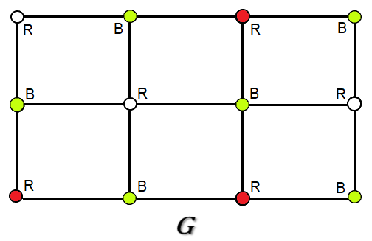
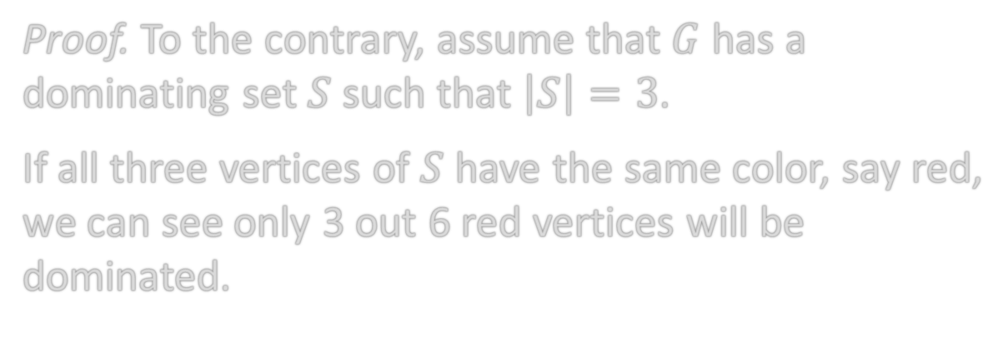
3 Red Vertices
Proof. To the contrary, assume that $G$ has a dominating set $S$ such that $\left|S\right|=3$.
If all three vertices of $S$ have the same color, say red, we can see only 3 out 6 red vertices will be dominated.

Slide 12
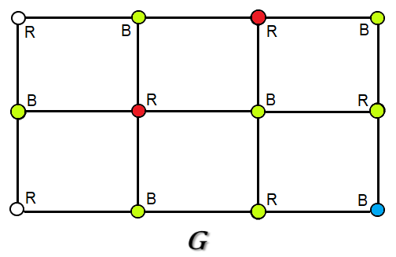
2 Red & 1 Blue Vertices
Proof. To the contrary, assume that $G$ has a dominating set $S$ such that $\left|S\right|=3$.
If all three vertices of $S$ have the same color, say red, we can see only 3 out 6 red vertices will be dominated.
Thus, there must be one vertex with different color.
Let 2 of those vertices be red, and the other be blue.
Still, not all vertices are dominated.
Therefore, we must choose what red vertices and what blue vertex should be used.

Slide 13
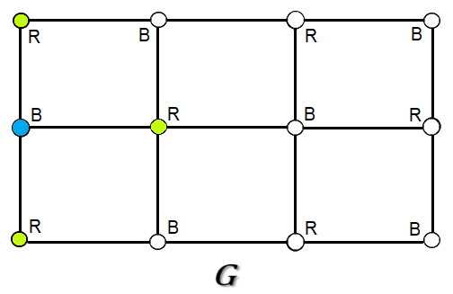
If Blue Vertex Has Degree 3...
If the blue vertices has degree 3 or lower, then it can only dominate at most 3 red vertices which makes the total of 5 out of 6 red vertices dominated.

Slide 14
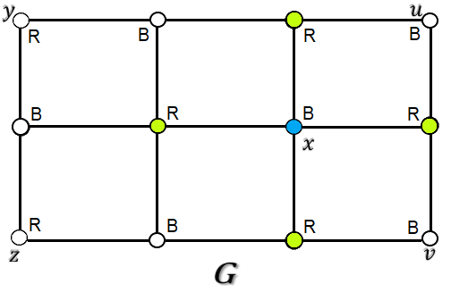
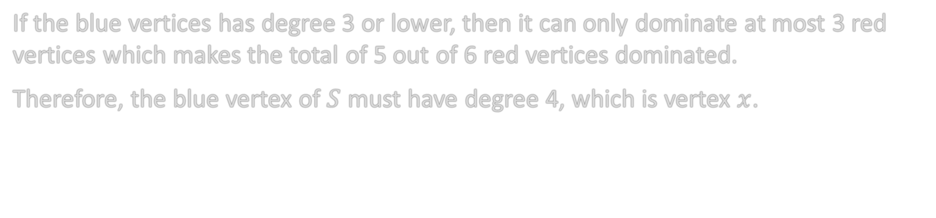
Blue Vertex Must Have Degree 4!
If the blue vertices has degree 3 or lower, then it can only dominate at most 3 red vertices which makes the total of 5 out of 6 red vertices dominated.
Therefore, the blue vertex of $S$ must have degree 4, which is vertex $x$.

Slide 15
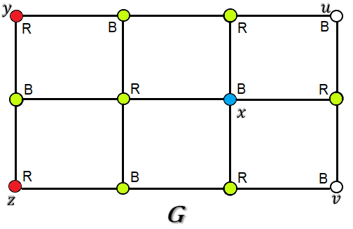
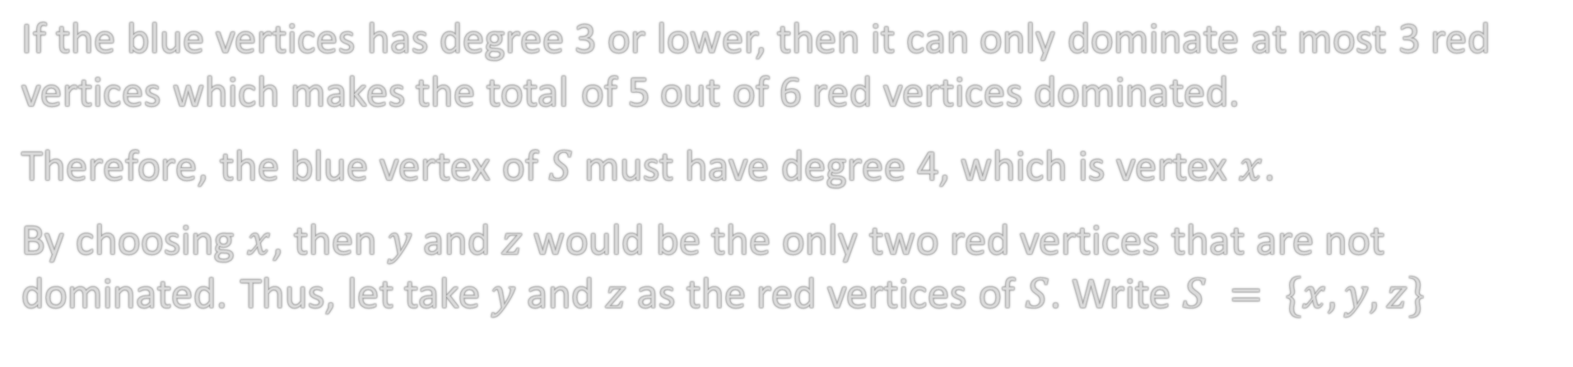
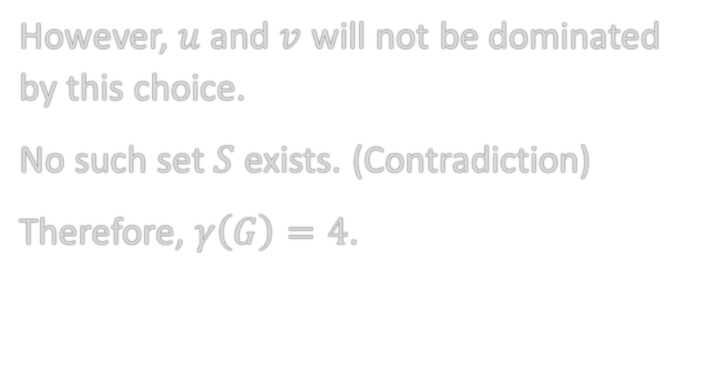
The Red Vertices Must Be…
If the blue vertices has degree 3 or lower, then it can only dominate at most 3 red vertices which makes the total of 5 out of 6 red vertices dominated.
Therefore, the blue vertex of $S$ must have degree 4, which is vertex $x$.
By choosing $x$, then $y$ and $z$ would be the only two red vertices that are not dominated. Thus, let take $y$ and $z$ as the red vertices of $S$. Write $S = \{x, y, z\}$
However, $u$ and $v$ will not be dominated by this choice.
No such set $S$ exists. (Contradiction)
Therefore, $γ\left(G\right)=4$.

Slide 16
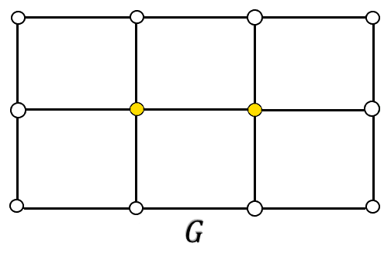
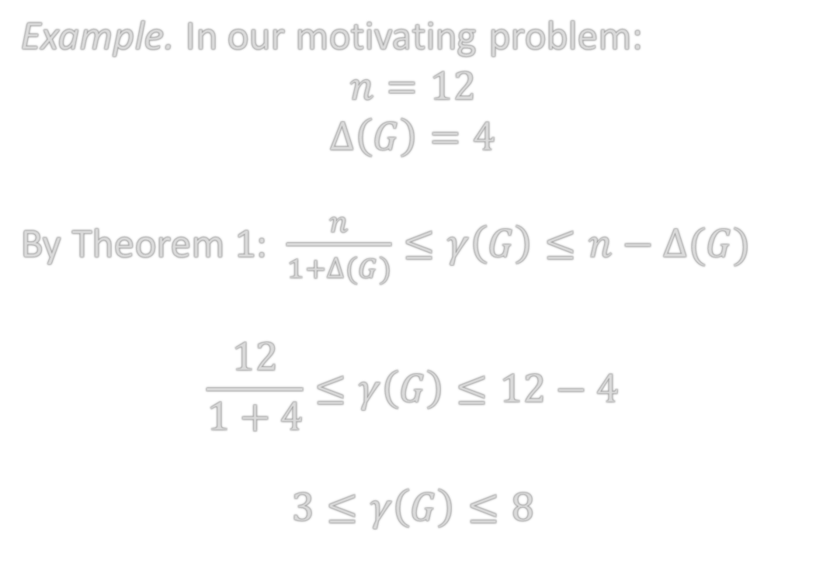
Bounds of Domination Numbers
Theorem 1. If $G$ is a graph of order n$,$ then $\frac{n}{1+∆(G)}≤γ\left(G\right)≤n−∆(G)$
Example. In our motivating problem:
$$n=12$$
$$∆\left(G\right)=4$$
By Theorem 1: $\frac{n}{1+∆(G)}≤γ\left(G\right)≤n−∆(G)$
$$\frac{12}{1+4}≤γ\left(G\right)≤12−4$$
$$3≤γ\left(G\right)≤8$$

Slide 17
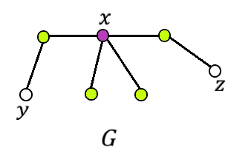

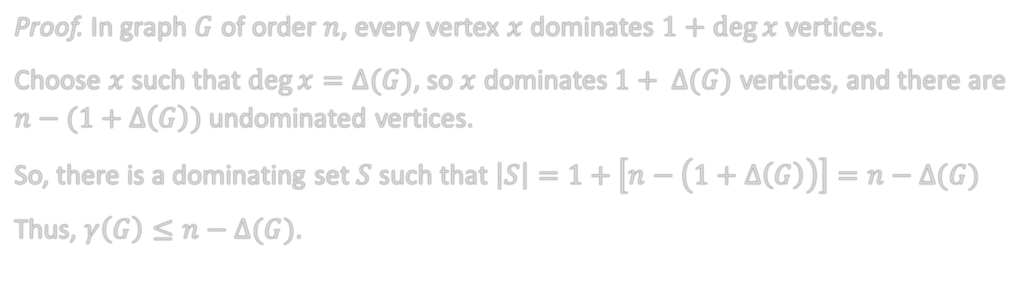
Choose $\deg{x}=∆(G)$
Theorem 1. If $G$ is a graph of order n$,$ then
$$\frac{n}{1+∆(G)}≤γ\left(G\right)≤n−∆(G)$$
Proof. In graph $G$ of order $n$, every vertex $x$ dominates $1+\deg{x}$ vertices.
Choose $x$ such that $\deg{x}=∆(G)$, so $x$ dominates$1+ ∆(G)$ vertices, and there are $n−(1+∆\left(G\right))$ undominated vertices.
So, there is a dominating set $S$ such that $\left|S\right|=1+\left[n−\left(1+∆\left(G\right)\right)\right]=n−∆(G)$
Thus, $γ\left(G\right)≤n−∆(G)$.

Slide 18
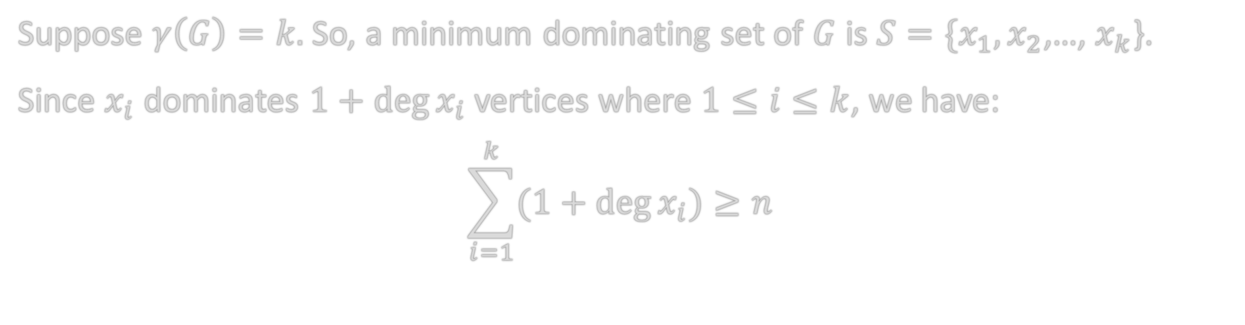
A Minimum Dominating Set
Theorem 1. If $G$ is a graph of order n$,$ then
$$\frac{n}{1+∆(G)}≤γ\left(G\right)≤n−∆(G)$$
Suppose $γ\left(G\right)=k.$ So, a minimum dominating set of $G$ is $S=\{x_{1},x_{2}$,…, $x_{k}$}.
Since $x_{i}$ dominates $1+deg{x_{i}}$ vertices where $1≤i≤k$, we have:
$$\sum_{i=1}^{k}{(1+\deg{x_{i}})}≥n$$

Slide 19
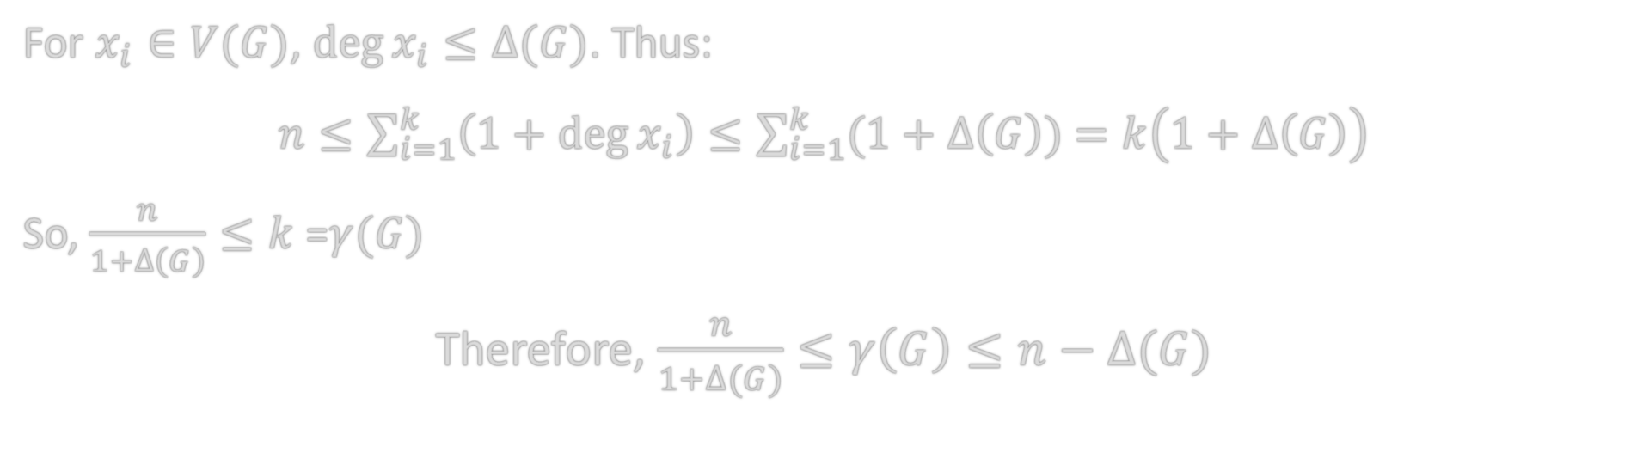
Because $\deg{x_{i}}≤∆\left(G\right)$…
Theorem 1. If $G$ is a graph of order n$,$ then
$$\frac{n}{1+∆(G)}≤γ\left(G\right)≤n−∆(G)$$
For $x_{i}∈V(G)$, $\deg{x_{i}}≤∆(G)$. Thus:
$n≤\sum_{i=1}^{k}{\left(1+\deg{x_{i}}\right)}≤\sum_{i=1}^{k}{(1+∆\left(G\right)})$ $=k\left(1+∆\left(G\right)\right)$
So, $\frac{n}{1+∆\left(G\right)}≤k$ =$γ(G)$
Therefore, $\frac{n}{1+∆(G)}≤γ\left(G\right)≤n−∆(G)$

Slide 20
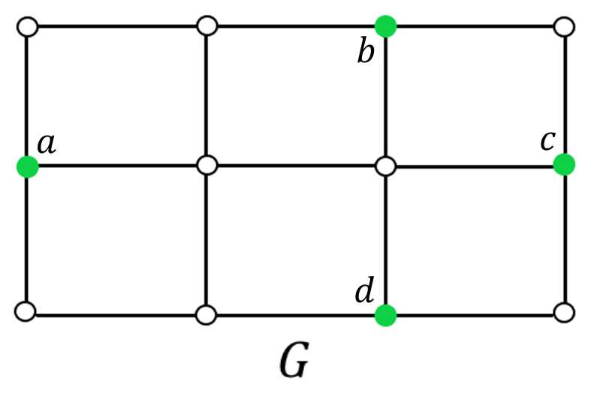
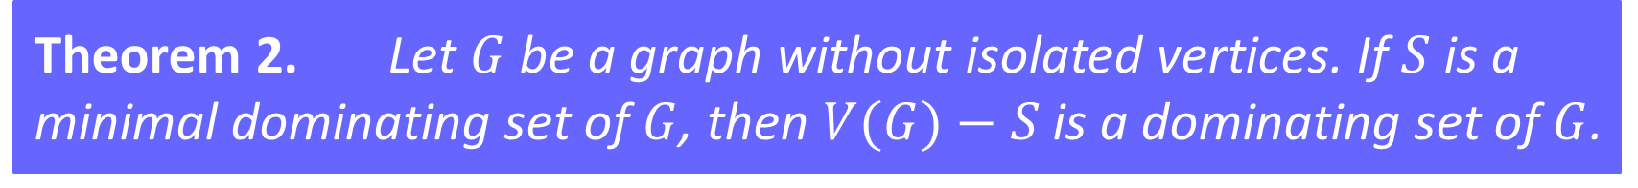
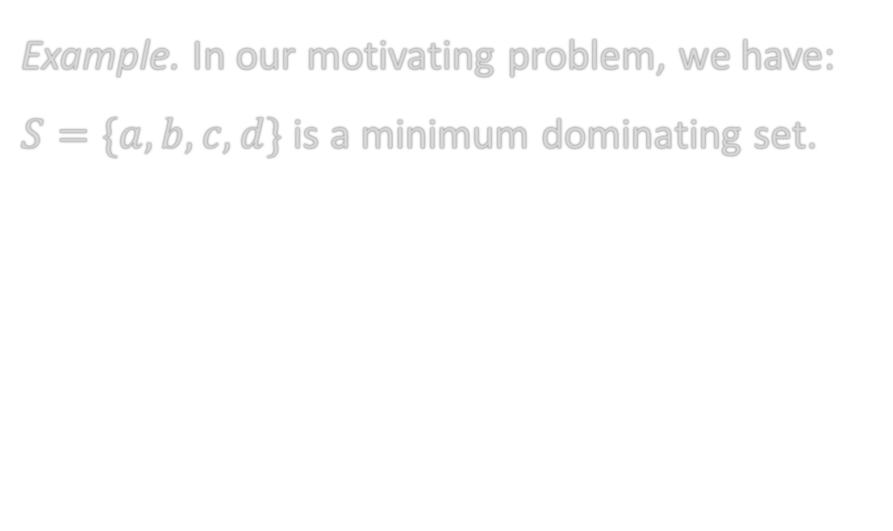
A Graph Without Isolated Vertices
Theorem 2. Let $G$ be a graph without isolated vertices. If $S$ is a minimal dominating set of $G$, then $V(G)−S$is a dominating set of $G$.
Example. In our motivating problem, we have:
$S=\{a, b, c, d\}$is a minimum dominating set.

Slide 21
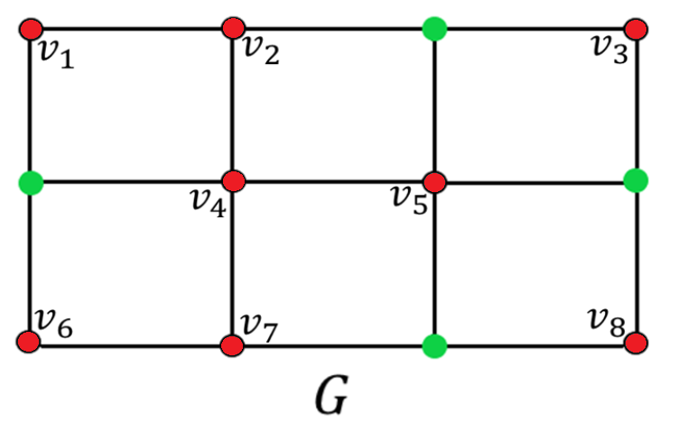
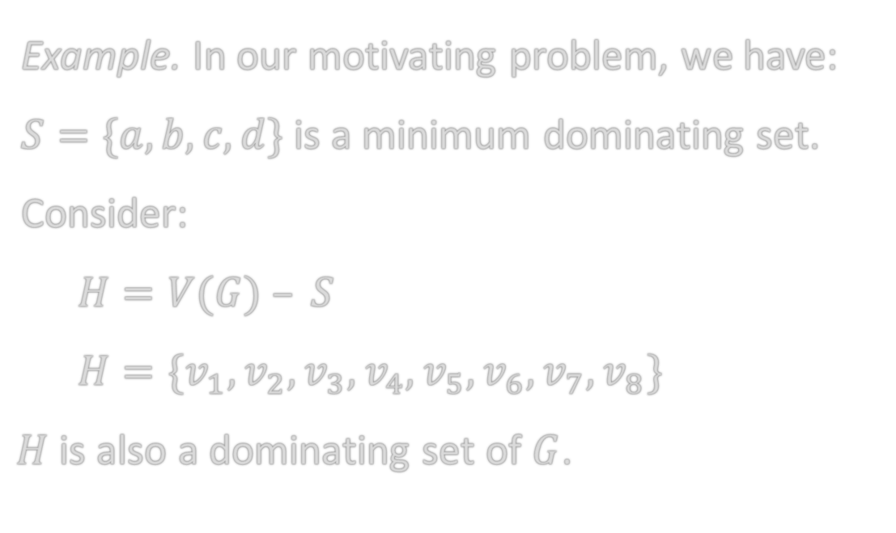
A Graph Without Isolated Vertices
Theorem 2. Let $G$ be a graph without isolated vertices. If $S$ is a minimal dominating set of $G$, then $V(G)−S$is a dominating set of $G$.
Example. In our motivating problem, we have:
$S=\{a, b, c, d\}$is a minimum dominating set.
Consider:
$H=V(G) – S$
$H=\{v_{1}, v_{2}, v_{3}, v_{4}, v_{5}, v_{6}, v_{7}, v_{8}\}$
$H$ is also a dominating set of $G$.

Slide 22
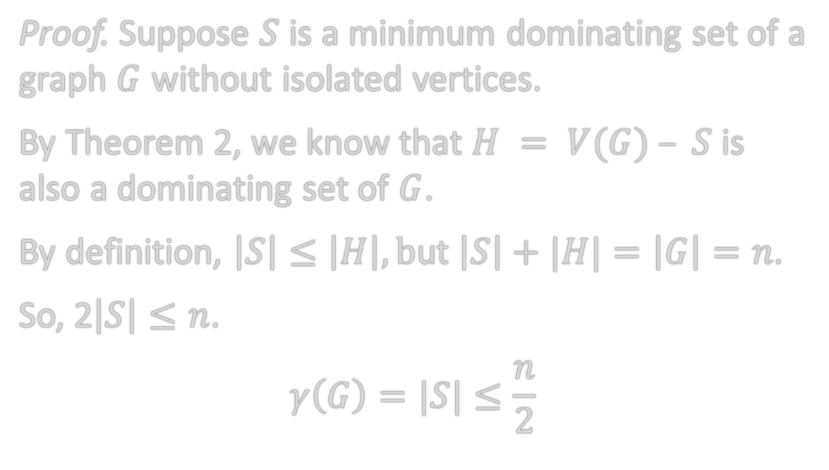

Bound of A Graph Without Isolated Vertices
Corollary 1. If $G$ is a graph of order n without isolated vertices, then
$$γ\left(G\right)≤\frac{n}{2}$$
Proof. Suppose $S$ is a minimum dominating set of a graph $G$ without isolated vertices.
By Theorem 2, we know that $H = V(G) – S$is also a dominating set of $G$.
By definition, $\left|S\right|≤\left|H\right|, b$ut $\left|S\right|+|H|=\left|G\right|=n$.
So, 2$\left|S\right|≤n$.
$$γ\left(G\right)=|S|≤\frac{n}{2}$$

Slide 23
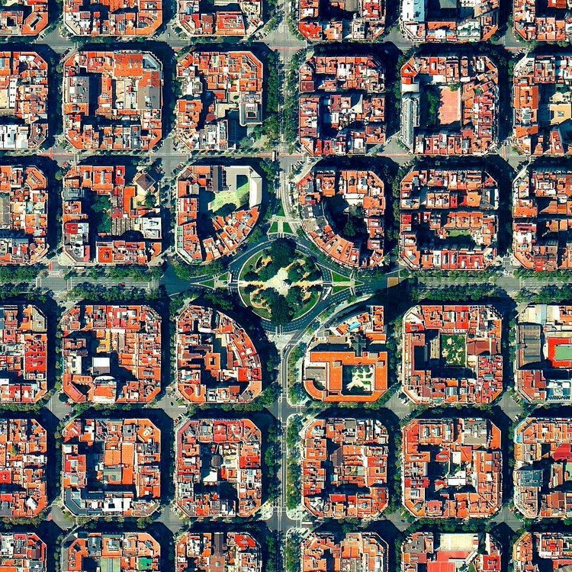
Application – City Blocks
Not all cities are built into perfect square blocks.
But they all represent graphs (vertices and edges)
Hence, the domination theory can be applied.
Domination number can be used for planning and budgeting (security, public wellness,…)

Slide 24
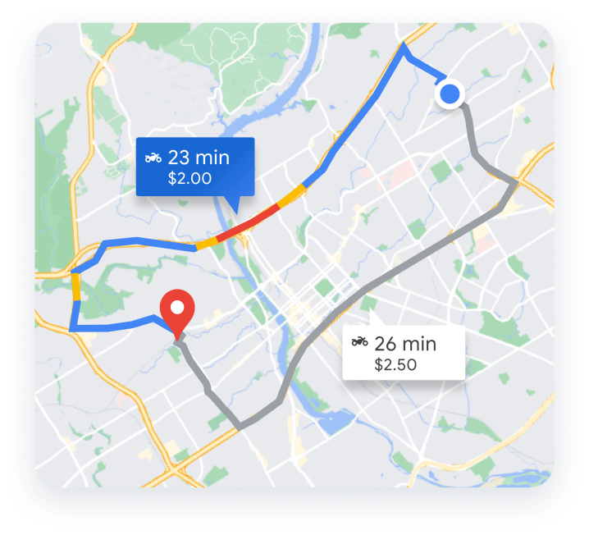
Application - GPS
Dominating sets are used to calculate the best routes.
GPS uses 24 satellites, that circle the Earth once every 12 hours, to provide information about position, time, velocity.

Slide 25

Application - Cyber Security
The domination theory in cyber security is represented as sending information through a network (vertices and edges)
Vertices in the dominating set in such a graph should securely pass information to all other vertices.
The theory can also be used to locate the minimum number of detection devices.

Slide 26
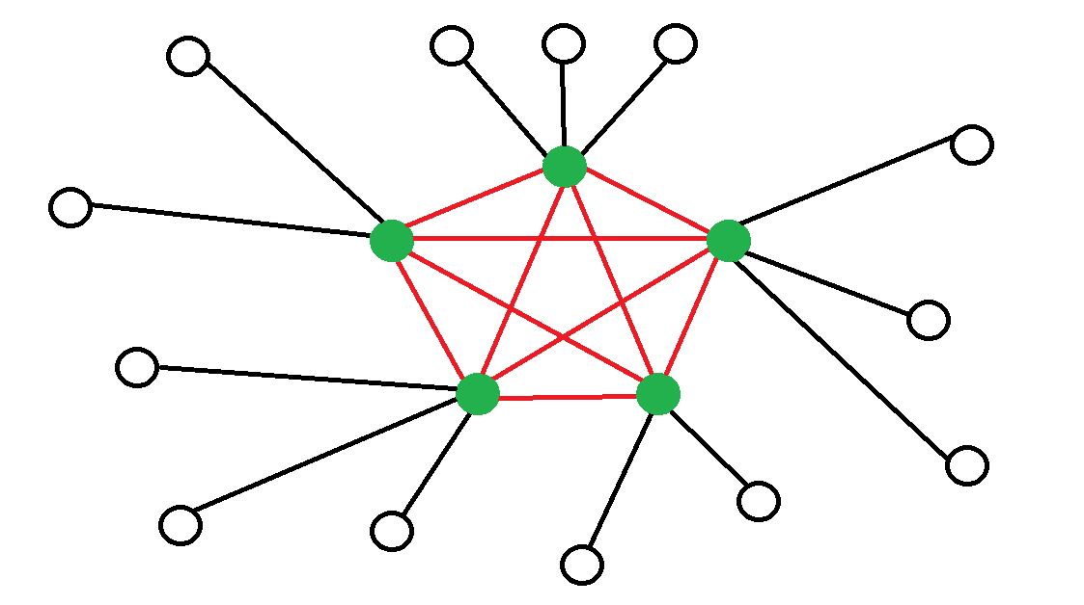
Application – Network Communication
Exchange of information between devices that are connected to a network.
A connected domination set can be used as the back-bone of network communication.
Internet is an example.

Slide 27
References
[1] Chartrand, Gary and Zhang, Ping. A First Course in Graph Theory. Western Michigan University. Dover Publications, Inc. Mineola, New York (2012)
[2] “Network Communication.” Dremio, www.dremio.com/wiki/network-communication/#:~:text=Network%20Communication%20refers%20to%20the,share%20data%20with%20one%20another. Accessed 22 Feb. 2024.
[3] Introduction to Global Positioning System, www.nh.gov/nhdfl/documents/introduction-to-global-positioning-system.pdf. Accessed 23 Feb. 2024.

Slide 28
THANK YOU!

